Slide 1
Tuesday 2nd February

Slide 2
AGENDA
Welcome
Public Health update – COVID data update: testing: vaccinations: South African Variant. In-school LTF testing (Sec/Prim)
Lockdown updates until February half-term including Free School Meals: Remote Learning (Focus work with 10 schools): IT & broadband provision: Pupil numbers.
SALT & Autism intervention – prevention.
Holiday & Food fund (Easter, Summer, Xmas breaks)
Professional Learning update
Primary - Moderation

Slide 3



Enfield COVID19 Dashboard
View in Power BI
Last data refresh:
29/01/2021 13:25:51 GMT Standard Time
Downloaded at:
29/01/2021 13:28:13 GMT Standard Time

Slide 4



ENFIELD COVID-19 DATA
TOTALS
(23 – 29 Jan 21)
Cases = 06 Mar 20 – 29 Jan 21
Deaths = 06 Mar 20 - 15th Jan 21
22 Jan
TOTAL
CASES = 27,782
DEATHS = 608
(508 excess#)
NEW CASES*
1,018
RECENT COVID DEATHS*
33
(35 excess deaths#)
Average age= 73.9
Range= 52- 100
Born outside UK=23
INFECTION RATE PER 100,000*
305
AGE GROUP
0-29 30-59 60+
INFECTION RATE RANK*
NCL# = 1
LON= 11; Eng= 38
TESTING RATE RANK
NCL# = 1
LON=12; Eng= 117
247
462
303
29 Jan update
25 Jan update
TESTS*
5,042
VACCINATIONS
28,403 1st DOSES
(excluding care homes)
2,868 2nd DOSES
(excluding care homes)
Care homes
Staff Residents
SCHOOLS AFFECTED
28
WARDS WITH MOST CASES* (TOP THREE)
Upper Edmonton (115)
Enfield Highway (99)
Ponders End (99)
CARE HOMES AFFECTED
16
No of deaths= 1
Staff = 11 cases
Residents = 16 cases
per 100,000
(PCR = 6,750 tests; lateral flow = 10.080 tests-2nd highest number in London)
Staff = 33 cases
Students = 14 cases
DOM CARE AFFECTED
14
Care Staff = 5 cases
Clients = 14 cases
389
1,053
#According to ONS weekly mortality analysis.
#North Central London includes Camden, Barnet, Enfield, Haringey & Islington
Change since last week of data

Slide 5
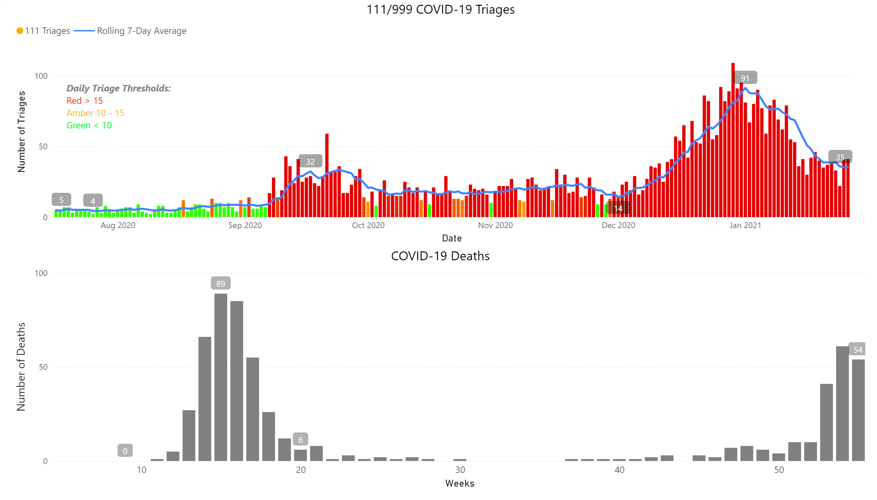
Charts
Notes:
111/999 COVID-19 Triages
No alt text provided.
COVID-19 Deaths
No alt text provided.
textbox
No alt text provided.

Slide 6

Weekly Age Stratified Infection Rates – 5-Year Age Brackets
 | Average weekly infection rate (last week) | Average weekly infection rate (last two weeks)
0-4 years | 167.60 | 186.45
5-9 years | 121.60 | 152.00
10-14 years | 98.38 | 162.55
15-19 years | 214.29 | 354.59
20-24 years | 538.01 | 724.44
25-29 years | 463.37 | 630.35
30-34 years | 428.53 | 587.75
35-39 years | 426.81 | 606.62
40-44 years | 467.56 | 657.64
45-49 years | 408.38 | 579.28
50-54 years | 434.18 | 547.06
55-59 years | 515.97 | 611.79
60-64 years | 433.63 | 530.71
65-69 years | 388.85 | 461.76
70-74 years | 293.01 | 370.85
75-79 years | 200.24 | 241.46
80-84 years | 305.90 | 351.79
85-89 years | 227.04 | 302.72
90+ years | 390.12 | 520.16

Slide 7
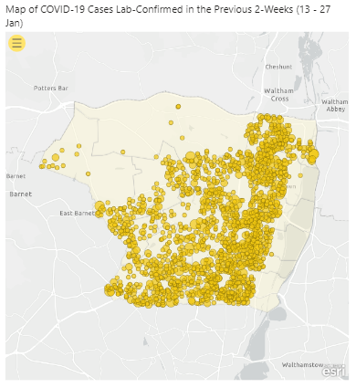
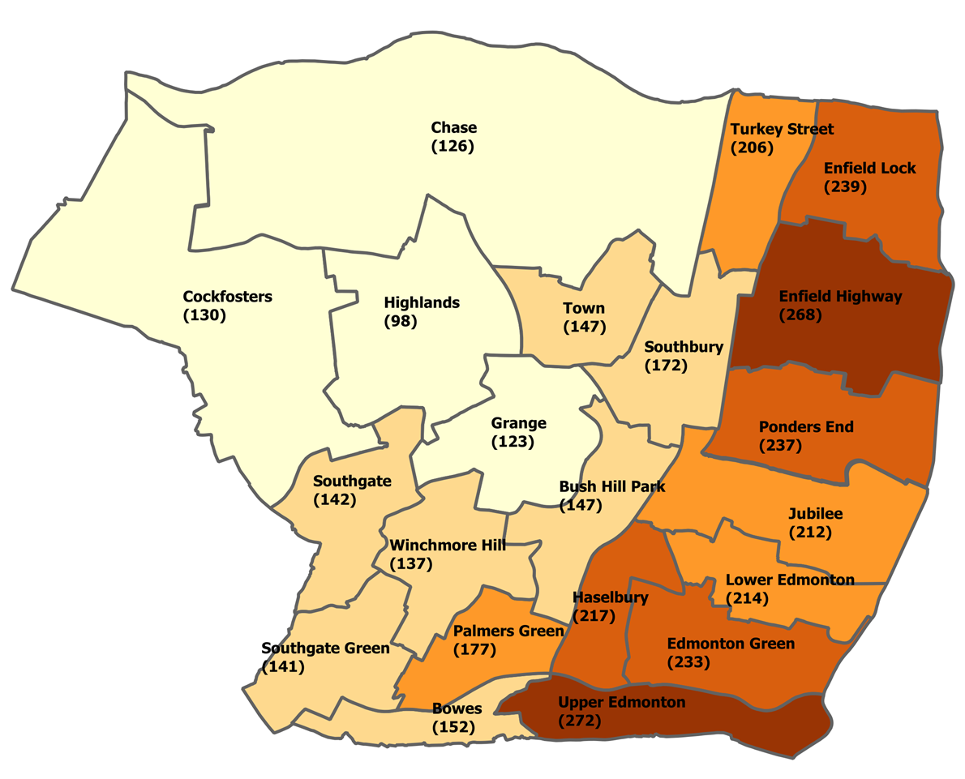
Maps (1)
Map of COVID-19 Cases Lab-Confirmed in the Previous 2-Weeks (13 - 27 Jan)
Map of COVID-19 Cases Lab-Confirmed in the Previous 2-Weeks (13 - 27 Jan)
Notes:
Map of COVID-19 Cases Lab-Confirmed in the Previous 2-Weeks (13 - 27 Jan)
No alt text provided.
Map of COVID-19 Cases Lab-Confirmed in the Previous 2-Weeks (13 - 27 Jan)
No alt text provided.

Slide 8
COVID-19 Vaccine Uptake : Enfield as at 28.01.21
Number of Vaccine decliners as at 28th Jan= 291
Mostly;
Black
Turkish/ Cypriot residents.
Low vaccine uptake among:
Black
Turkish
Polish
Bulgarian
Data source: NCL HealtheAnalytics COVID-19 vaccinations dashboard EMIS refresh 28th Jan 2021.
Updated on 31st Jan 2021 at 8.45 pm.

Slide 9
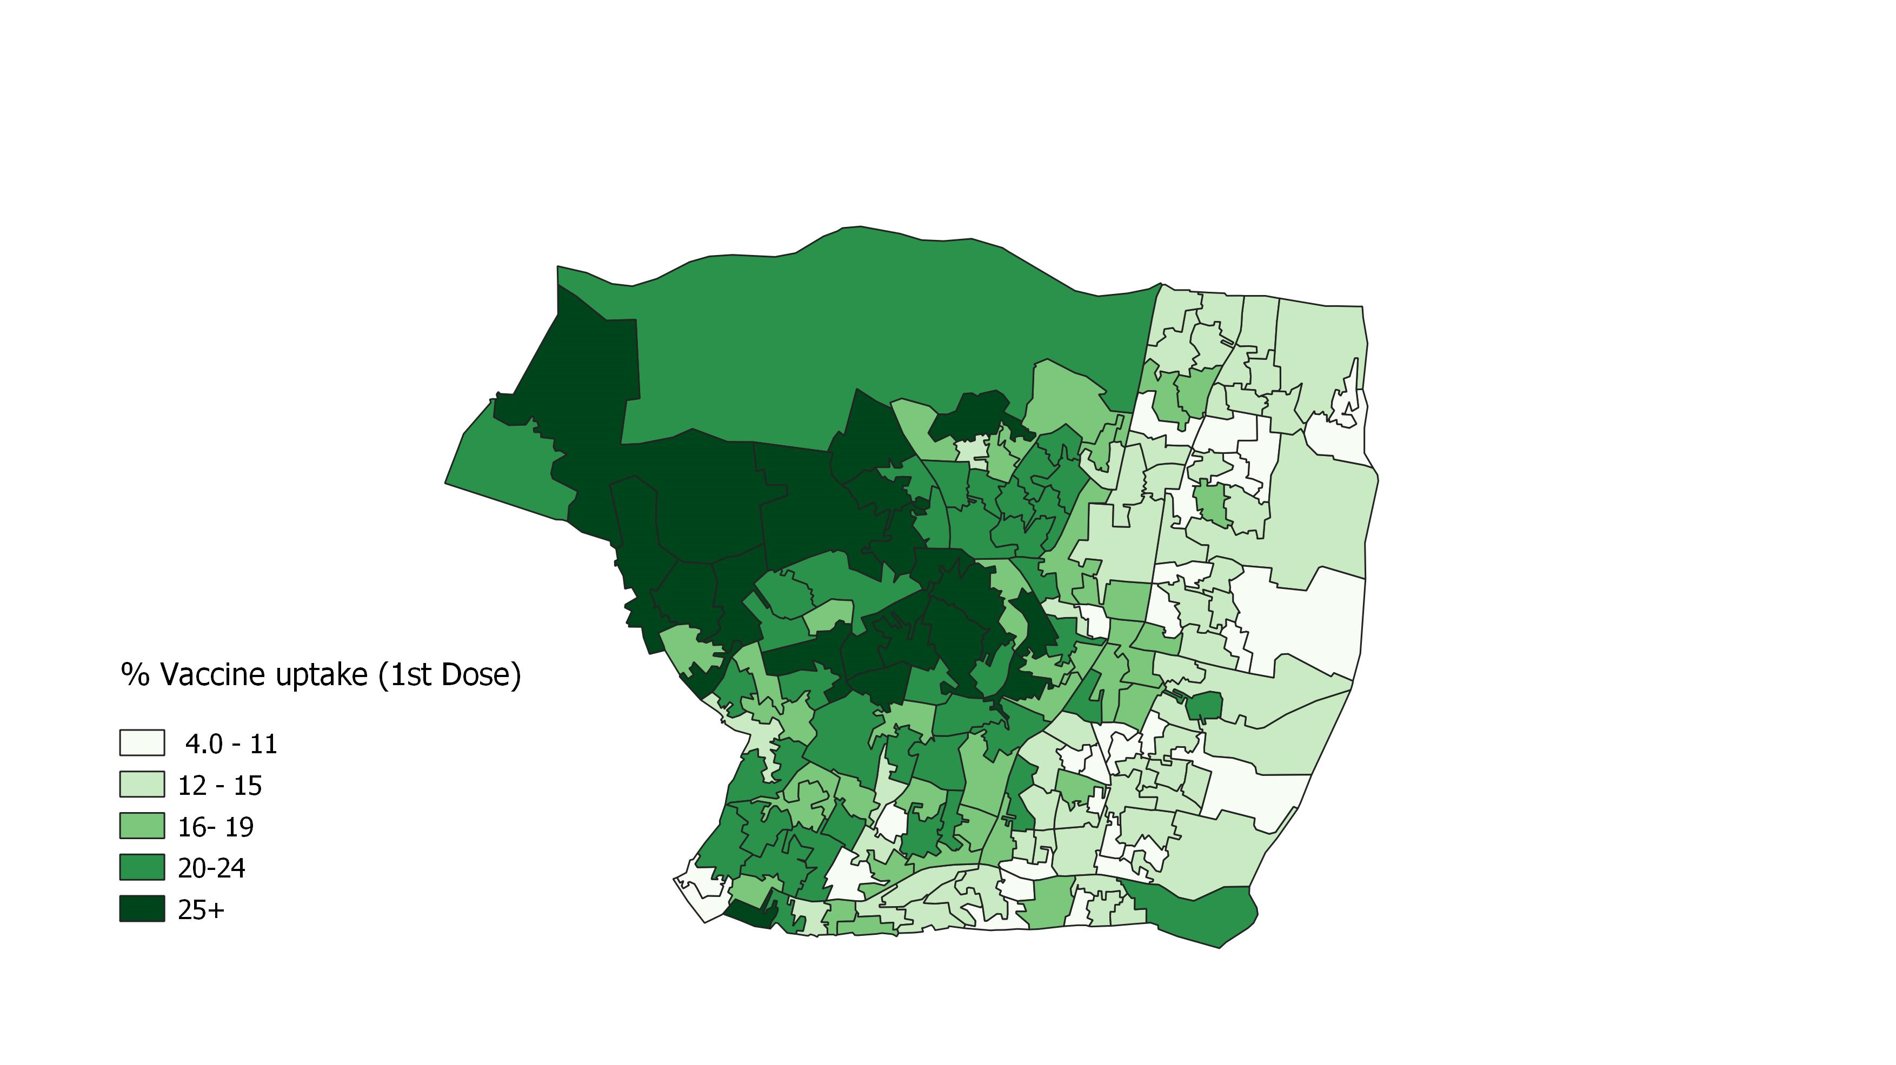
COVID-19 Vaccine 1st Dose % Uptake – 26.01.21

Slide 10


What do we know about South African variant?
Striving for excellence
www.enfield.gov.uk

Slide 11
What do we know about the South African variant?
Non travel related cases of SA variant have been identified in the UK in a small number of postcodes indicating that there maybe some community transmission.
Individuals over 16yrs old living in those postcodes have been asked to get a test and only go out of their homes if absolutely necessary.
Testing areas include 8 areas – Surry, London, Kent, Hertfordshire, Southport and Walsall. (W7, N17, CR4,WS2, ME15,PR9,EN10,GU21)
There are many strains of Coronavirus – this was first identified in South Africa in October 2020 and quickly became the dominant strain in SA.
Spreads easily similar to Kent variant that is dominant in the UK.
No evidence that SA variant causes more severe disease.
The existence of the variant is unlikely to affect vaccine efficacy, but further laboratory studies are required. Public Health England expect vaccines to have a similar level of effectiveness, particularly in reducing hospitalisation and death.
https://www.uhb.nhs.uk/coronavirus-staff/clinical-info-pathways/clinical-info-pathways-downloads/CovidPHECovidSAVariant.pdf
https://www.haringey.gov.uk/news/south-african-variant
https://www.hertfordshire.gov.uk/about-the-council/news/news-archive/10000-residents-in-broxbourne-urged-to-get-tested-amid-isolated-cases-of-new-covid19-variant

Slide 12
Key messages from Director of Public Health in Haringey.
People should still be going to work/GP/school if essential in these areas and essential visits to people in these area should continue.
People should still be getting vaccinated.
We are doing testing in a very focussed area to look to see if there is any further spread of the new variant locally and we will of course aim to contain of the cases identified.
We will contact residents in the areas we need to do testing.

Slide 13
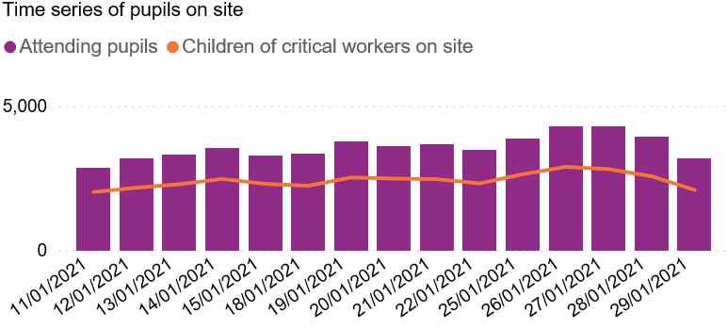
LOCKDOWN 3 ATTENDANCE
26.1.21
Total pupils 4297
(2564 critical workers children)
2pm 29.1.21 – response rate 68.47%
Total pupils 3188
(2085 critical workers children).

Slide 14

HT Moderation Briefing
2 February 2021
Suzi Modi
LA Moderation Manager
suzi.modi@enfield.gov.uk
Striving for excellence
www.enfield.gov.uk
Notes:
OFSTED updates
SATs cancelled- implications
Lost and missed learning
Early years updates
Engagement model
Remote learning and targeted teaching
Moderation and gathering evidence
Internal/cross moderation - Sonia Furneaux Whole school task
Transition
Resources:
Literacy Trust
Literacy Shed
BBC bitesize
https://get-help-with-remote-education.education.gov.uk/
https://www.gov.uk/government/publications/whats-working-well-in-remote-education/whats-working-well-in-remote-education

Slide 15
Reminder: cancellation of 2021 NC assessments
The following assessments, scheduled between April and July 2021, have been cancelled:
KS1 TA including moderation
KS2 tests and TA including moderation
phonics screening check
all statutory trialling
This includes cancellation of statutory assessment of pupils working below the standard of NC curriculum assessments.

Slide 16
What STA say…
Schools do not need to complete any further activities to prepare for these assessments. Local authorities will not need to undertake monitoring or moderation activities. We know that schools will continue to use assessment to inform teaching, to enable them to give information to parents on their child’s attainment in their statutory annual report and to support transition of KS2 pupils to secondary school. We strongly encourage schools to use past test papers in their assessment of pupils.

Slide 17
…continued
These arrangements will apply for summer 2021 only, and we are planning for a full programme of primary assessments to take place in the 2021/22 academic year. This will include the introduction of the statutory reception baseline assessment and multiplication tables check, as previously announced. We will confirm full details for 2021/22 primary assessments in due course.

Slide 18
How can we moderate writing internally and with other schools?

Slide 19
Organising internal writing moderation
Aims:
Strengthen summative assessment through formative action and consensus
Building on strengths and good features of writing against ARE and beyond
Identifying gaps and setting targets
Inform and support transition
Developing effective teaching and learning strategies to inform planning and move children on
Conduct cross-moderation activities with other schools to support standardisation

Slide 20
Setting a standardised writing task in Enfield
All schools use a shared stimulus
Set common task for all children
Teachers use their normal teaching and learning strategies
Select a range of scripts which reflect pupils on track to achieve:
WTS
EXS
GDS
Use these samples for cross-moderation
Notes:
Caroline share Eldon examples

Slide 21
Suggested approach
Each class teacher to:
Select a minimum of 3, maximum of 6 pupils
Sample should represent the lower, middle and upper ranges of attainment in your class
Select 2/3 pieces of independent writing for each child
This should include a narrative and a piece of non-fiction writing.

Slide 22
COVID safe method
Ensure that books/scripts have been quarantined for 72hrs
Scan the selected samples of writing for your chosen children and upload to a shared area on the school system
Organise zoom/teams moderation sessions with partner teacher/s
Engage in professional discussion with reference to the shared samples
Notes:
Theo at Alma has organised this with schools in their trust.

Slide 23
Suggested discussion framework
Through discussion:
Draw out evidence of what the child can do against the NC objectives
Identify the gaps and areas for development
Set SMART writing targets to share with pupils and teachers
Develop teaching and learning strategies/interventions to move children on
Inform planning and precision teaching
Reach an agreement regarding your assessment and judgements

Slide 24
Towards cross-moderation
Once this process is established, it can be opened out to partner schools
Samples that have been agreed on and standardised within schools can be shared virtually with partner teachers
The same or adapted discussion framework can be used as a guide to aid dialogue
Build in regular sessions, choosing different children and samples

Slide 25
100% Moderation zoom workshops
We will continue to provide opportunities for moderation at our 100% workshops for all schools
Last term’s workshops were well attended with over 400 teachers across KS1 and KS2
KS1
Tues 23 March-1.30-4pm
Thur 25- March-1.30-4pm-Repeat
KS2
Tues 20 April-1.30-4pm
Thur 22 April-1.30-4pm-Repeat
Invites to follow
Notes:
Suzi

Slide 26
Further information
This has been be shared with SIAs, Moderators and Literacy subject leaders
The next Literacy Subject Leader session is on:
Wednesday 10 February-1.30-3.30pm
Please book colleagues to attend for further information
www.enfieldpdonline.org.uk
course reference ENF/21/56

Slide 27
Links
EYFS Exemplification
https://assets.publishing.service.gov.uk/government/uploads/system/uploads/attachment_data/file/360534/ELG10___Writing.pdf
KS1 Writing Exemplification
https://www.gov.uk/government/publications/2018-teacher-assessment-exemplification-ks1-english-writing
KS2 Writing Exemplification
https://www.gov.uk/government/publications/2018-teacher-assessment-exemplification-ks2-english-writing

Slide 28

https://youtu.be/3QrjmYK5mTA

Slide 29
What does assessment look like in your school?
Next steps…
How can meaningful AfL happen remotely?
How are you gathering evidence?
What are you doing with this data?
How will you provide transitional information in Y2 and Y6?

